Slide 1
Classification Techniques

Slide 2
Agenda
Types of variables
Regression vs Classification
Classification Techniques
Logistic Regression
Confusion Matrix
Evaluation Metrics
K-Nearest Neighbors
Decision Tree/ Regression Tree

Slide 3
Types of Variables
Quantitative/ Numeric Variables
Discrete - comes from counting
e.g. number of books sold
Continuous - comes from measurement
e.g. weight, height
Qualitative/ Categorical Variables
Nominal - labels
Color: Red, Green, Blue; Gender: Male, Female
Ordinal - ordered list
Income: High, Medium, Low; Questionnaire on scale of 1 to 5

Slide 4
Regression vs Classification
Regression | Classification
Dependent variable is numeric | Dependent variable is categorical
Techniques - Linear Regression, Regression Tree etc. | Techniques - Logistic Regression, Decision Tree etc.
Evaluation Metric - RMSE, Rsq etc. | Evaluation Metric - Accuracy, F1 score etc.
Example - Predicting salary of employees | Example - Spam filtering

Slide 5
Classification Techniques
Logistic Regression
Naive Bayes
K-Nearest Neighbors
Decision Tree
Random Forest
XGBoost
SVM
Can we apply linear regression?

Slide 6
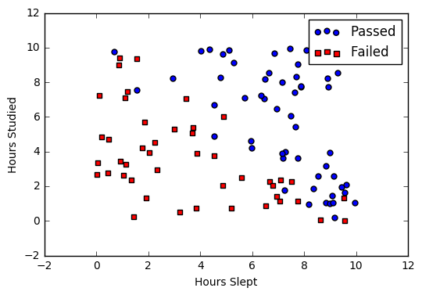
Logistic Regression
Studied | Slept | Passed
4.85 | 9.63 | 1
8.62 | 3.23 | 0
5.43 | 8.23 | 1
9.21 | 6.34 | 0
Reference - https://ml-cheatsheet.readthedocs.io/

Slide 7
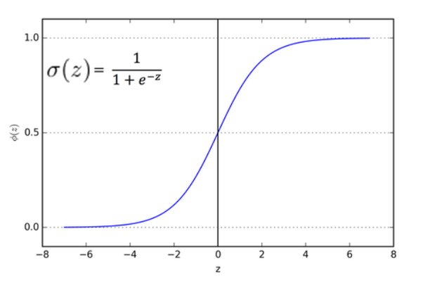
Logistic Regression
Assumptions -
Dependent variable is categorical
Observations are independent of each other
Little/no multicollinearity between features
Linearity of features and log odds
Sigmoid Function

Slide 8
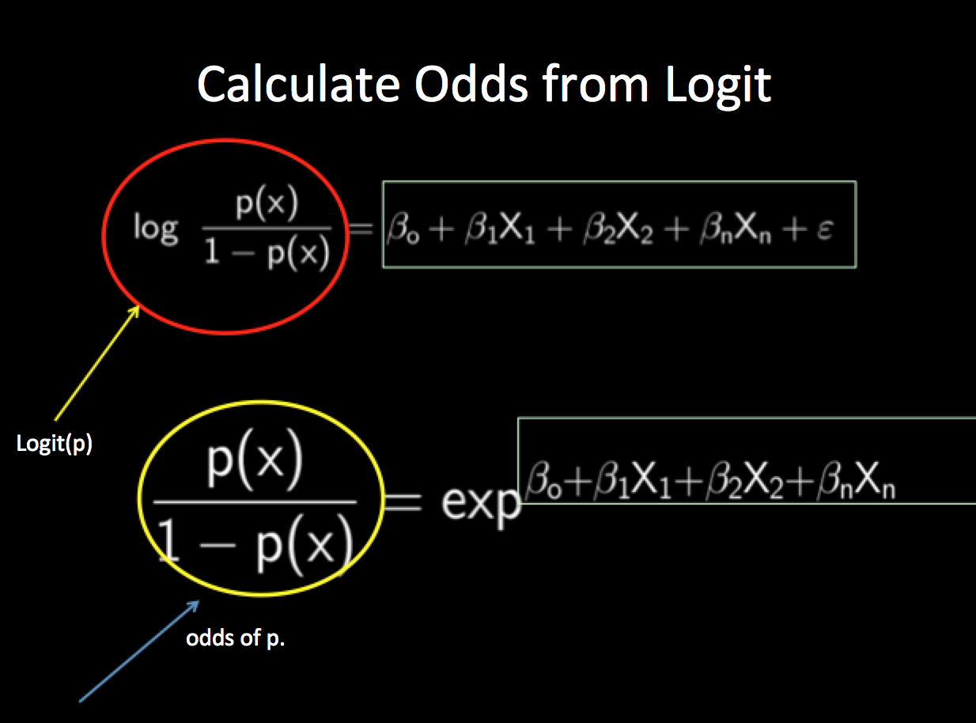
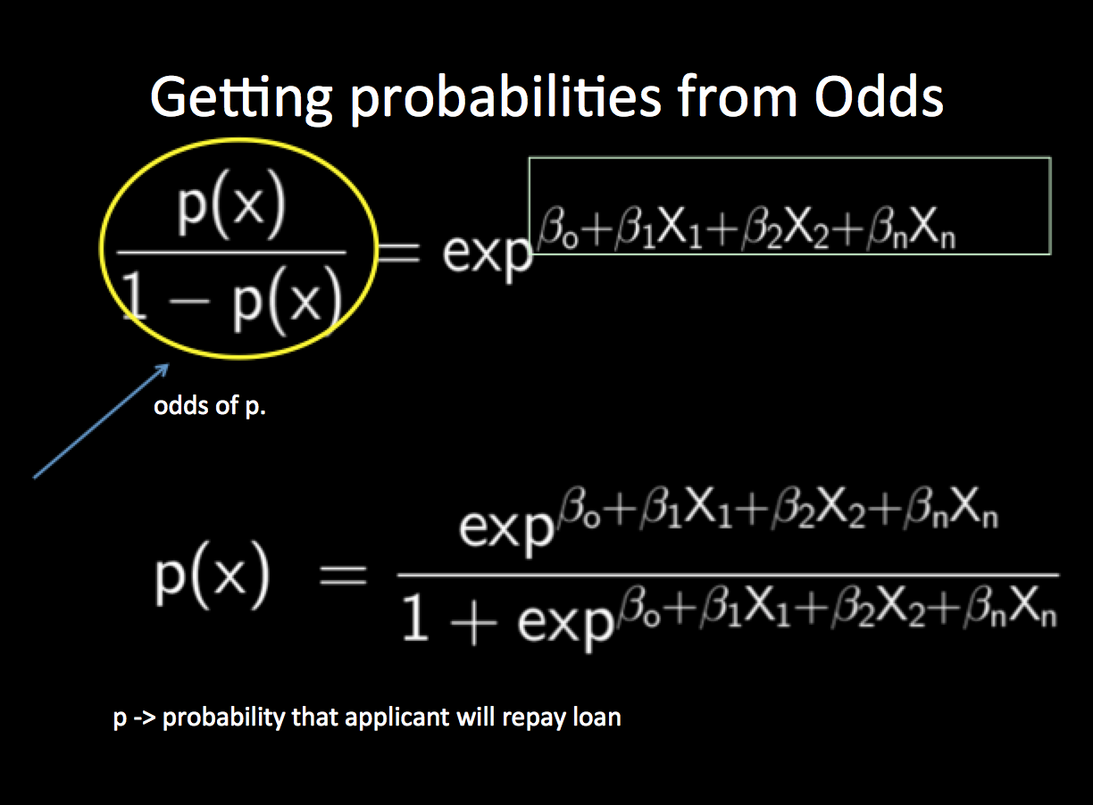
Logistic Regression
Reference - https://pmirla.github.io/

Slide 9
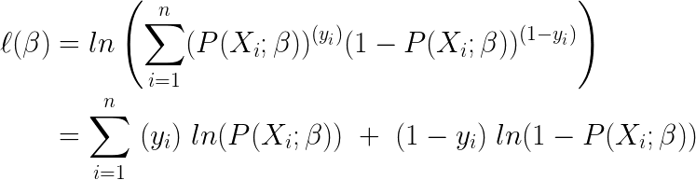
Logistic Regression
Maximum Likelihood:

Slide 10
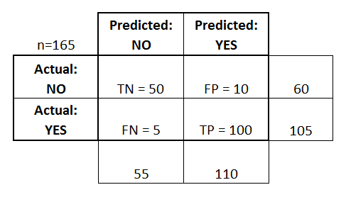
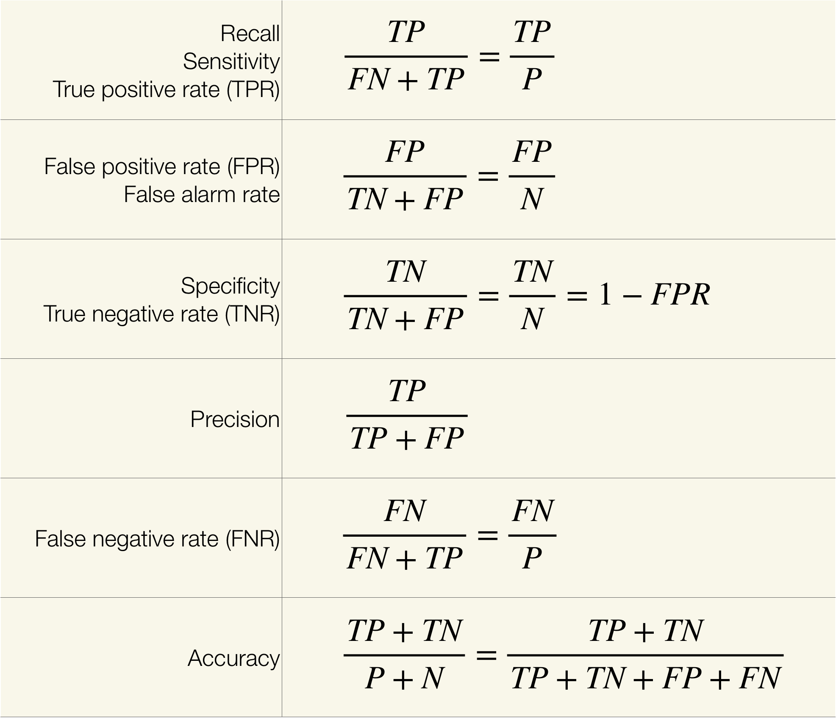
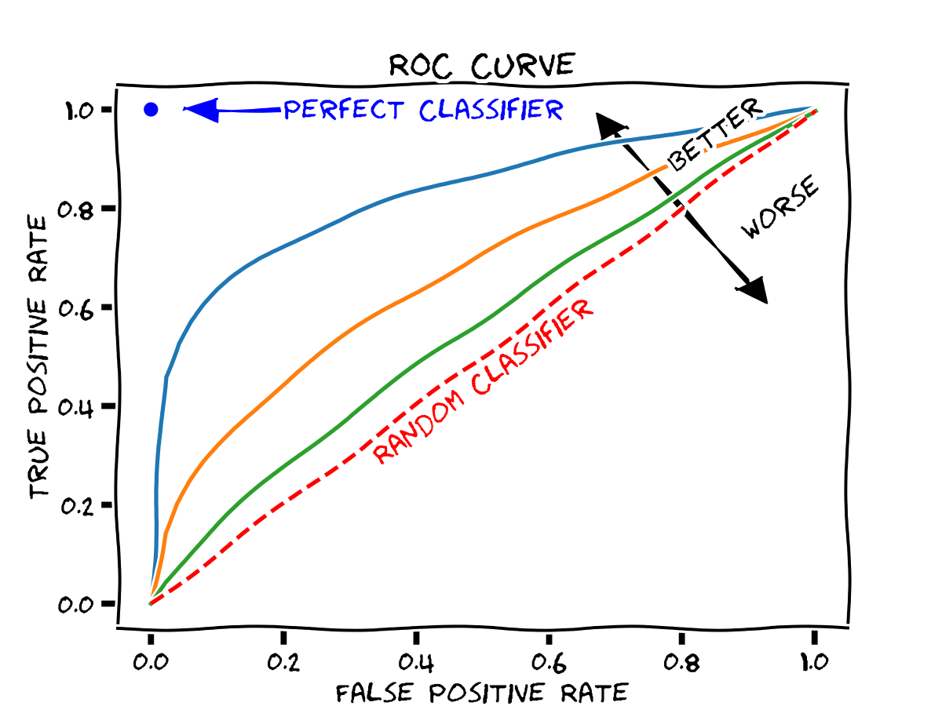
Confusion Matrix

Slide 11
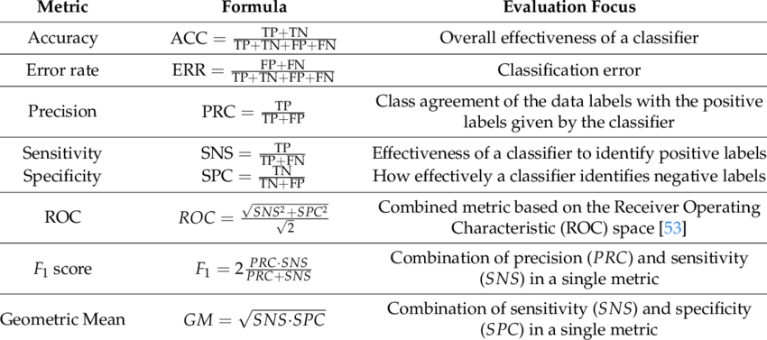
Evaluation Metrics
Reference -https://www.researchgate.net/

Slide 12
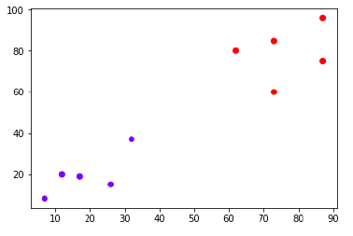
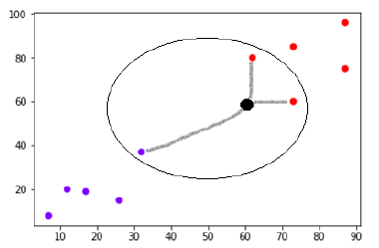
K-Nearest Neighbors

Slide 13
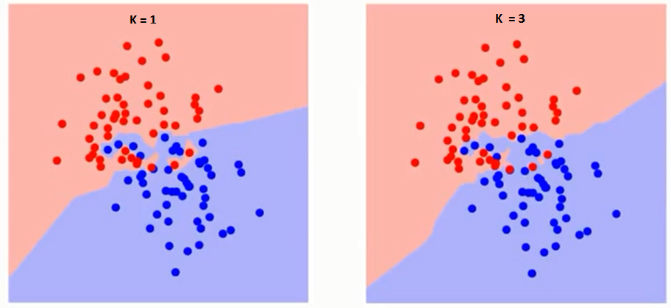
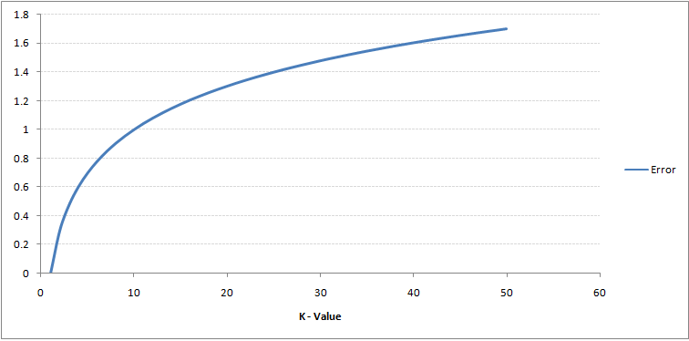
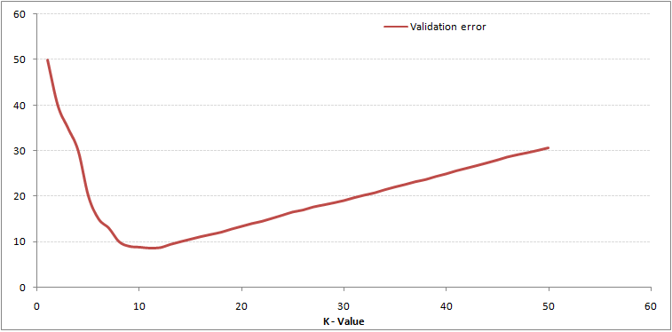
Choosing the right value of K
Reference -https://www.analyticsvidhya.com/

Slide 14
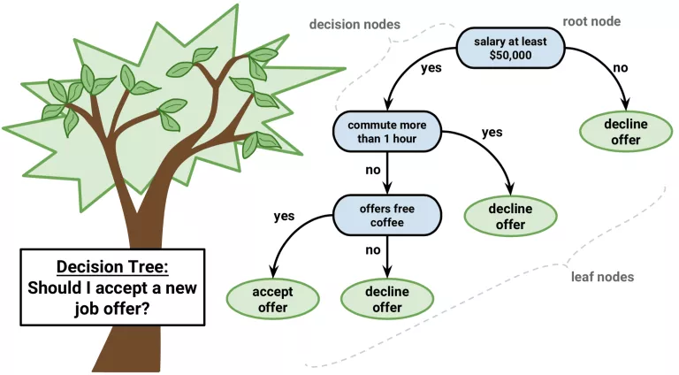
Decision Tree/ Regression Tree
Assumptions -
At the beginning, the whole training set is considered as the root
Feature values are preferred to be categorical. If the values are continuous then they are discretized prior to building the model
Records are distributed recursively on the basis of attribute values
Order to placing attributes as root or internal node of the tree is done by using some statistical approach
Gini
CHAID
Entropy
Reference -https://dataaspirant.com/

Slide 15
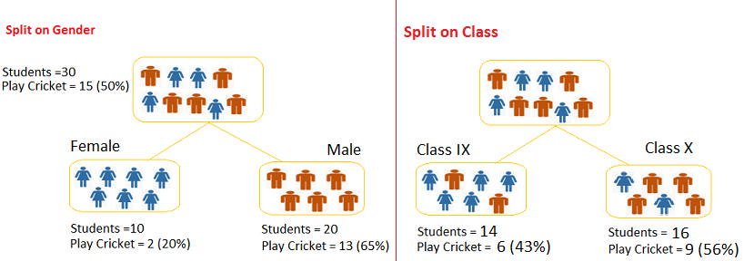
Decision Tree/ Regression Tree
Gini for sub-node Female = (0.2)*(0.2)+(0.8)*(0.8)=0.68
Gini for sub-node Male = (0.65)*(0.65)+(0.35)*(0.35)=0.55
Weighted Gini for Split Gender = (10/30)*0.68+(20/30)*0.55 = 0.59
Gini for sub-node Class IX = (0.43)*(0.43)+(0.57)*(0.57)=0.51
Gini for sub-node Class X = (0.56)*(0.56)+(0.44)*(0.44)=0.51
Weighted Gini for Split Class = (14/30)*0.51+(16/30)*0.51 = 0.5
Split on Gender is higher than Split on Class, hence, the node split will take place on Gender
Reference -https://www.analyticsvidhya.com/

Slide 16
Decision Tree/ Regression Tree
Advantages - Explainable, Few hyper parameters
Disadvantages - Prone to overfitting, Low accuracy
Overfitting - Pruning helps in reducing overfitting

